Slide 1
RUNGTA COLLEGE OF DENTAL SCIENCES & RESEARCH
TITLE OF THE TOPIC-ENDODONTIC MISHAPS
DEPARTMENT OF – CONSERVATIVE DENTISTRY AND ENDODONTICS

Slide 2
Specific learning Objectives
At the end of this presentation the learner is expected to know ;
Core areas* | Domain ** | Category #
Introduction | Cognitive | Must know
Method | Psychomotor | Must know
Armamentarium | Cognitive | Must know
*Subtopic of importance
** Cognitive, Psychomotor or Affective
# Must know , Nice to know & Desire to know
( Table to be prepared as per the above format )

Slide 3
Contents
Introduction
Definition
Classification
Access related
Instrumentation related
Obturation related
Miscellaneous
Conclusion

Slide 4
OBTURATION-RELATED MISHAPS

Slide 5
Where should be the apical termination of the root canal filling ??
General agreement is at or near – dentinocemental junction

Slide 6
Under- or Overextended Root Canal Fillings
Cause:
A) Under extension
Failure to fit master cone accurately.
Poorly prepared canal - apical
B) Over extension:
Apical perforation with loss of constriction.

Slide 7
Correction :
Under extended filling- Re-treatment
B) Over extended filling - more difficult.
Successful - entire point removed with one tug.
Gutta-percha and many sealers - generally well tolerated
do not automatically require surgical removal
If symptoms persist - surgical removal

Slide 8
Prognosis:
Underextension - if lesion present or apical canals have necrotic or infected materials prognosis
B) Overextension - adequate seal - successful.

Slide 9
Prevention:
Confirmation and adherence to working length
Taking a radiograph during the initial phases of the obturation to allow for corrective action, if indicated.

Slide 10
Vertical Root Fractures
Instrumentation / Obturation / Post placement.
Recognition:
1. Sudden crunching sound
2. Pain reaction
3. A suggestive “teardrop” radiolucency
4. Deep periodontal pocket of recent origin in a tooth with a
long-present root canal filling
5. Exploratory surgery
Notes:
Predisposing factors include loss of healthy tooth
substance, as a result of caries and trauma, which
increases the risk for cracks in the body of dentin that
can later propagate to fracture (35, 36). The unique
anatomy of the susceptible roots (37), i.e., the narrow
mesiodistal dimension compared with the buccolingual,
makes these roots and teeth susceptible to
fracture, especially at a later stage when additional
tooth structure is removed during root canal and dowel
preparations (38, 39). Moisture loss in pulpless teeth
(9), previous cracks in the dentin (40), and loss of
alveolar bone support

Slide 11
Management :
Unfortunately in most cases, extraction is the only treatment available.
Use of CO2 and Nd–YAG laser to fuse fractured roots was tested in an in vitro study, but proved ineffective
Bonding of the extracted fragments with adhesive resin cement
Hemisection or root amputation of the fractured root may be the
treatment of choice
Prevention:
1. Avoidance of overpreparing canals (“overflaring”)
2. Passive obturation and post placement
3. Full cuspal coverage

Slide 12
MISCELLANEOUS
1) Post Space Perforation
Recognition:
Similar to that of instrumentation related lateral root perforations:
Correction:
Sealing the perforation, if possible.
Prognosis:
Least affected - totally within bone.
Gingival sulcus – periodontal breakdown
A 15% failure rate - areas other than the furcation (Rud J et al)

Slide 13
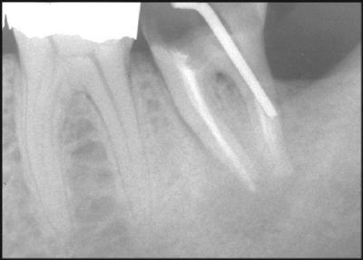
Prevention:
Knowledge of canal anatomy
Planning based on radiographic information
Preparing the space at the time the root canal is obturated
Hot instrument or a file vs. Round bur or an end-cutting bur

Slide 14
2) Irrigant-Related Mishaps
Any irrigant- potential to cause problems if extruded
Sodium hypochlorite - immediate inflammatory response followed by tissue destruction
Hydrogen peroxide - Tissue emphysema

Slide 15
Recognition :
Pain and swelling.
Interstitial hemorrhage, and ecchymosis.
Depend on solution, concentration and amount

Slide 16
Prognosis:
Favorable - immediate treatment & proper management
Long term effects - Paresthesia, scarring, and muscle weakness.
Prevention:
Passive placement of needle.
No attempt should be made to force the needle apically
The needle must not be wedged into the canal
The solution should be delivered slowly and without pressure.

Slide 17
Treatment:
Antibiotics
Analgesics
Antihistamines
Ice packs, then warm saline soaks
Intramuscular steroids
Hospitalization and surgical intervention
Monitoring
Sodium hypochlorite injected into maxillary sinus- immediate lavage with sterile water or saline.

Slide 18
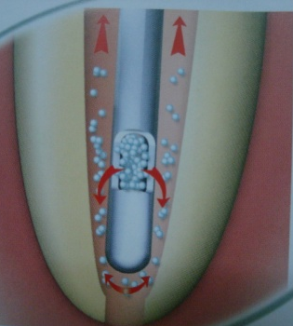
Special endodontic irrigating needles
Monoject Endodontic Needle with a modified tip and side orifice or the blunt-end Prorinse
Check the hub of the needle for a tight fit
Notes:
to prevent separation and accidental exposure of the irrigant to the patients eyes.

Slide 19
Tissue Emphysema
Passage and collection of gas in tissue spaces or fascial planes.
Subcutaneous or periradicular air emphysema
Cause :
compressed air being forced into the tissue spaces.
Canal Preparation - blast of air to dry the canal
Irrigation past the apex with H2O2.
3. Apical Surgery - air from a high-speed drill.

Slide 20
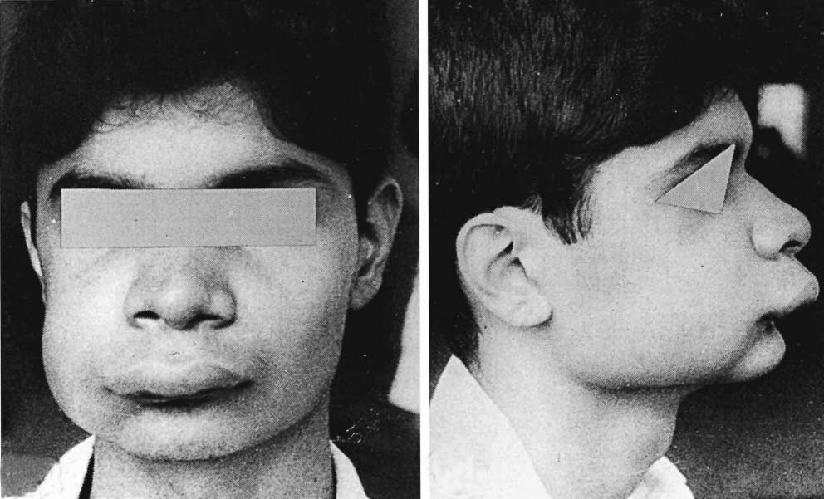
Recognition:
Rapid swelling, erythema.
Pain
Dysphagia and dyspnea
Mediastinum - death.

Slide 21
Correction:
Palliative care and observation to immediate medical attention
Broad-spectrum antibiotic coverage
Benign course followed by total recovery.
Prevention:
1. Using paper points to dry root canals.
2. Air syringe - horizontal positioning over the access(Jerome)
3. In surgical procedures – apical access- handpieces- do not direct jets of air into surgery sites.

Slide 22
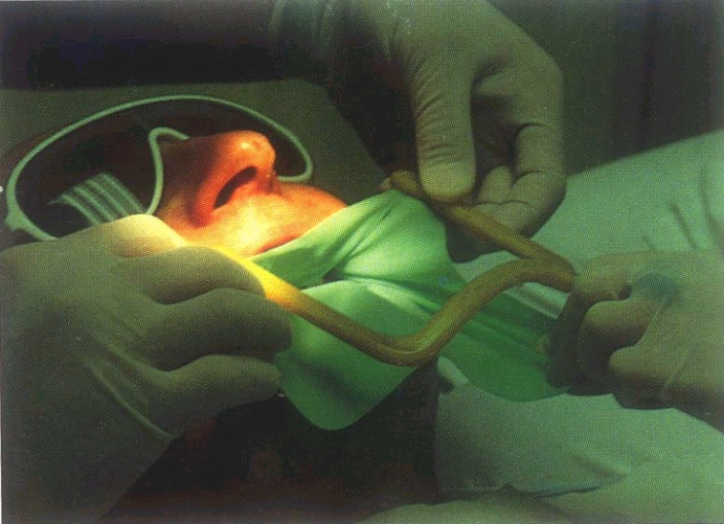
Instrument Aspiration & Ingestion
1. Endodontic instruments
2. Rubber dam clamps
Recognition:
Radiographs of the chest and abdomen

Slide 23
Correction :
1. In the dental operatory - removal of accessible objects
High-volume suction
Hemostats and cotton pliers
2. Once aspiration - medical emergency facility
Prevention:
1. Proper tooth isolation with rubber dam is essential to all phases of RCT particularly patient protection and asepsis.
2. Attaching floss to the clamp before placement.

Slide 24
TAKE HOME MESSEGE/ FOR THE TOPIC COVERED (SUMMARY)
Prevention of mishaps can be done by-
Reviewing each tooth’s morphology prior to entering its pulp space.
Thorough examination of pre-operative radiographs is the paramount step to avoid this mishap.
Checking the long axis of the tooth and aligning the long axis of the access bur with the long axis of the tooth - tipped tooth.
Following principles of access cavity preparation, adequate size and location, both permitting direct access to the root canals.

Slide 25
Question & Answer Session
1. Causes and correction of under and over extended fillings.
2. Write in brief about post space perforation.
3. Write about irrigant related mishaps.

Slide 26
References
Ingle JI, Bakland LK. Endodontics. 4th ed. Philadelphia:Williams and Wilkins; 1995.
Grossman LI, Oliet S, Del Rio C. Endodontics. 11th ed. Philadelphia: Lea and Febiger; 1988
Rowe AHR. Damage to the inferior dental nerve during or following endodontic treatment. Br Dent J 1983;153:306
Seltzer S, Bender IB, Turkenkopf S. Factors affecting successful repair after root canal therapy. J Am Dent Assoc 1963;67:651
Walia H, et al. Use of a hemostatic agent in the repair of procedural errors. JOE 1988;14:465.

Slide 27
THANK YOU

